Slide 1
Protecting the Elderly from Cybercrime: A Community Education Approach
Sydney Brazeau, 2020

Slide 2
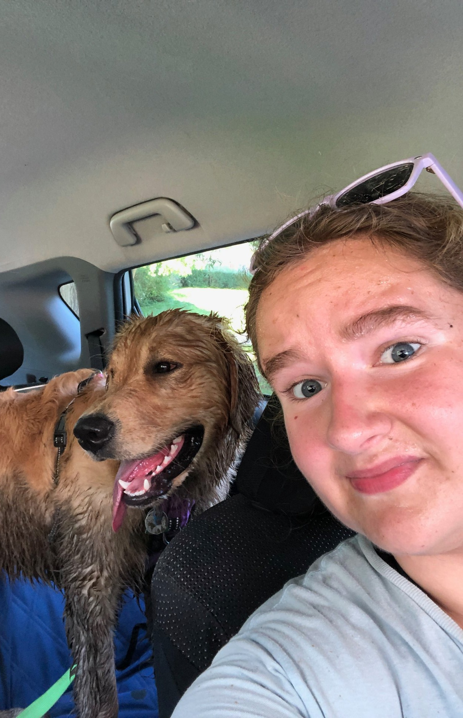
$ whoami
Born and raised in Alaska
Now live in Maryland
Golden Retriever Mom
BEM in Homeland Security and Emergency Management from University of Alaska Fairbanks
MS in Cybersecurity Studies
Twitter: @BrazeauSydney

Slide 3

Capstone Project
Cybercrime victimization of the elderly
Computer and ICT use
Generational communication styles
Developed a curriculum packet
Notes:
Elderly at highest risk for being defrauded online
Explored the “why”
Computers are used for:
connecting with friends and family
Banking information
Health information
ICT = information communication technology
Generational values shaped by historical events -> plays into communication preferences
Available technologies during early adulthood

Slide 4
Cybercrime Victimization
In 2019, adults over the age of 60:
lost $835,164,766 to internet crimes
are 5x more likely to lose money to tech support scams
lost on average of over $600
Notes:
1. that were reported to the FBI in 2019 (IC3)
2. than other age groups (FTC, 2019).
3. per fraud incident in 2018 (FTC, 2019).

Slide 5
Most Common Fraud Types
Phishing
Spoofing
Tech support scams
Lottery scams
Romance fraud
Government imposters
Credit Card Fraud
Notes:
According to the FTC, 2019
My community education packet addresses the following fraud types: ...
Tech support scam: Call and say you have a problem with your computer. Runs fake diagnostics. Requires payment in gift cards or to be wired money.
Lottery Scam: Must pay “upfront taxes” in order to claim prize. E-mail saying you have won the lottery, when you didn’t even buy a ticket
Romance fraud: Dating website scammer pretends to fall in love and then asks for money for a sick relative.
Government imposter: e-mail says it’s from the IRS
All of these interactions occur mainly online these days

Slide 6
Fraud Victimization Cycle in Senior Citizens
Fraud (Re)Victimization
Shame from Being Victimized
Fear of Loss of Independence
Withdrawal from Friends and Family
Depression and Loneliness
Notes:
Why are the elderly more prone to fraud victimization than other age groups?
Part of the reason is the fraud victimization cycle
Victimization of seniors occurs in a self-reinforcing cycle due to a number of compounding factors // self perpetuating

Slide 7

The Aging Brain
Cognitive decline is the single largest factor of senior citizen fraud victimization
Ventromedial prefrontal cortex (vmPFC)
First part of the brain to decline
Responsible for:
Decision Making
Filtering good vs. bad information
Safety
Notes:
vmPFC decline is linked to:
Poor financial literacy
Poor financial decision-making skills
Linked to “Halo effect” around advertising

Slide 8

Community Education Programs
Help senior citizens spot and avoid cyberfraud
Foster ways of thinking about personal information
Develop concrete skills to prevent and mitigate identity theft
Should be tailored to generational and cultural learning preferences
In-person classes help develop a sense of community
Addresses loneliness
Notes:
Challenges preconceived notions of information security
-Personal information isn’t just your bank account/credit card number
-Can include details about workplace, address, birthdays, family members, etc.
-Spearphishing e-mails are used to confirm these details before committing fraud
Older adults have a lower level of confidence in the computer skills than their younger counterparts but are willing and able to learn safe practices

Slide 9
Senior Citizen Learning Preferences
Lecture style
Authoritative teacher
Use a microphone
Graphics and Videos should supplement text, not replace it
Think in terms of accessibility
Notes:
Lecture style as opposed to exploratory learning
Bulleted lists
One way to do things
Prefer written lists of instructions
Prepare for generational, geographic, and cultural

Slide 10

Curriculum Packet
Lesson Plan
30-minute PowerPoint
10 question quiz and answer key
Quick reference handout
Step-by-step skills handout
Framework for curriculum updates
Notes:
Lesson plan is for a 1-hour in-person class
PowerPoint covers how to identify and avoid common cyberscams and basic skills building
Quiz challenges common misconceptions like:
True or false: If you don’t use a computer, your personal information cannot be exploited by cybercriminals.
Quick-reference/ Cybercrime handout covers common cybercrime types, how to avoid and mitigate cybercrime, and what to do if you are a victim of a cybercrime
“How to” covers computer updates, anti-virus updates, setting up online banking, setting up a credit freeze, how to set up a fraud alert on your credit, and how to report scams/identity theft and cybercrimes

Slide 11
Framework for Updates
Draw information from trusted resources
1
Analyze cybercrime trends by both frequency and impact
2
Be mindful of cultural differences
3
Make sure materials are presented in an accessible format
4
Notes:
Trusted Resources: AARP, NIST, FTC, FBI/IC3,
Password and authentication data from NIST
Cybercrime trends from IC3
Scam trends from the FTC
Cybercrime frequency and impact available from IC3
Cultural differences and values: i.e. rate of speech
Accessable = large print font, use microphone, provide handouts, make sure location of class is accessible to the mobility impaired

Slide 12
National Level Resources
AARP (American Association of Retired Persons)
Fraud Watch Network Helpline
“Report a Scam” for nationwide scam tracking
IC3 (Internet Crime Complaint Center)
Part of the FBI
“File a Complaint” form available online
For internet crime reporting
FTC (Federal Trade Commission)
FTC Complaint Assistant
For scam reporting
IdentityTheft.gov
Notes:
AARP helpline:
Provides emotional support
guidance for families
steps to take after being victimized
referrals to law enforcement
IC3
Provides consumer and industry alerts
According to website: “Information is processed for investigative and intelligence purposes for law enforcement and public awareness”
FTC Complaint Assistant
INCLUDES: INTERNET SERVICES, ONLINE SHOPPING, OR COMPUTERS
“The FTC does not resolve individual complaints”
Online form to report
The FTC runs IdentityTheft.gov as a one stop shop for the identity theft recovery process

Slide 13

Community Resource Development
Recommendation: Senior Fraud and Cybercrime Hotline
Provides support through resources and “listening ear”
Reduces revictimization
Reduces feelings shame, loneliness, and depression
Local and State Government
Local police often lack resources for cyberfraud investigations
Reporting structure should include IC3
Healthcare
Fraud victimization is a healthcare issue
Indication of cognitive decline – APS involvement
Social withdrawal and depression
Notes:
APS – Loss of independence

Slide 14
Breaking the Fraud Victimization Cycle Requires:
Fraud (Re)Victimization
Shame from Being Victimized
Fear of Loss of Independence
Withdrawal from Friends and Family
Depression and Loneliness
Community education programs
Community groups and activities to combat loneliness
Clear government and law enforcement reporting structures
Mental health resources

Slide 15
Further Resources/Contact
Website: www.sydneybrazeau.me
GitHub: catsandotherthings
Twitter: @BrazeauSydney

